Slide 1
AI based Integrated Health Club management system
PRESENTED BY,
DIVYA KENNADY
S6 MCA
LLMC18MCA014
MAIN PROJECT
PROJECT COORDINATOR:
Prof NEETHU.MOHAN
INTERNAL GUIDE:
Prof BISMI.S.CHARLEYS

Slide 2
01
CONTENTS
ABSTRACT
02
EXISTING SYSTEM
PROPOSED SYSTEM
MODULE DESCRIPTION.
.
03
DFD
DATABASE
SCREENSHOT
04
CONCLUSION
FUTURE ENHANCEMENT
REFERENCE

Slide 3

ABSTRACT
This is a cloud based Integrated software for complete Health Club management with features like Membership Management, Marketing Management, Reservations Management, Automatic Attendance Tracking, Event Management, virtual trainer and helpdesk, Class Management and auto class scheduling.
.All general enquiries related to all branches is also possible through help desk Can book and enquire about available slots for special activities like pool, yoga , gym etc.
. 24/7 access controls for clients.
Automatic Attendance Tracking system using face recognition and biometric system and marks attendance from multiple locations with a cloud stored database.
The Business Intelligence module is powered by machine learning algorithms. This will deliver fresh insights on how many gym members may be expected to leave a Health club at any given time. This data is based on club member actions taken, their preferences, and how similar members behave.
Admin module can communicate special offers, class schedules, payment confirmations, contract due dates, and can automate the sign-up process via the client portal for more member convenience.
Automated Recurring Payments:

Slide 4

Existing system
Auto guided customer registration is also not available, this might make admissions difficult
It is very difficult to manage the schedule of staff and user.
Attendance marking is done manually.
Payment process is difficult and no recurring payment notification is available .
It is difficult to calculate or keep track the amount of time spend at the health club of user and staff
No 24/7 client access is not available.

Slide 5
Proposed system
24/7 access controls for client acquisition at any time with the help of virtual assistant.
Virtual training is available for members of the health club
Payment automation .
Automated attendance of the members are tracked using biometric and face recognition.
Club kiosk can be communicated through voice bot and chat bot
Staff and users get automated notification about the Scheduling
Slot can be reserved online according to users choice
Chatbot will also present different exercise routines based on the intensity level the user chooses and is comfortable with.

Slide 6
MODULE AND DESCRIPTION
ADMINISTRATION (ADMIN)
VRITUAL HELP DESK
Admin have control over staff management, user management, equipment management, and billing.
In staff management, add, edit ,delete, view staff attendance, block/unblock staff.
In user management, approve/reject the online registration request from user. Also can view user attendance , add, update subscription paln.
In equipment management, add, view, delete inside the health club and can mark the location .
Billing, view or send invoices auto or manually.
View peak time and normal time
user
Voice to text conversion.
New user registration using voice/chat interface.
Doubts
Reply from bot generated with the help of dialog flow
Schedule/reschedule class
Check availability of trainers and contact details.
View payment history/ pay fee online
Admin
train bot using training interface
Add static and dynamic question using api.
Set/change language preferences.
Allow/block users to chatbot
ATTENDANCE TRACKING
Fetch attendance from biometric and mark logs.
Fetch attendance using face recognition using openCV.
Combine logs and auto prepare attendance report
Auto billing based on attendance and send report.

Slide 7
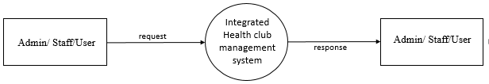
DATA FLOW DIAGRAM (DFD)
LEVEL 0 (CONTEXT LEVEL)

Slide 8
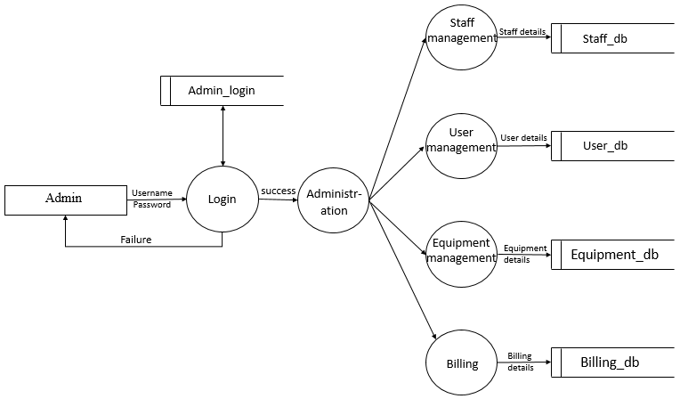
Level 1 for Admin

Slide 9
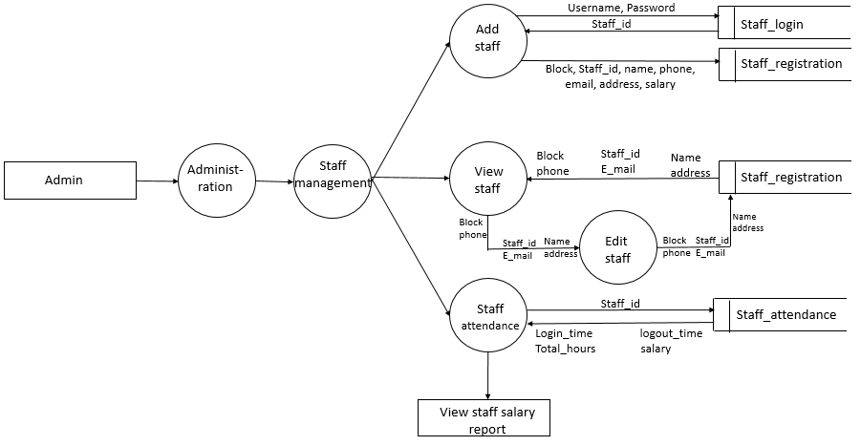
Level 1.1 for Admin ( staff management)

Slide 10

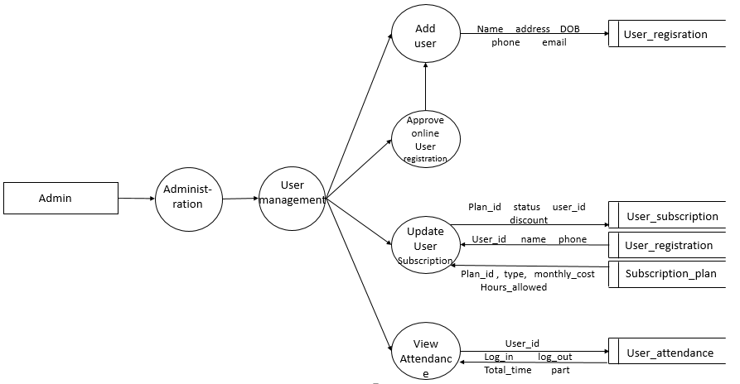
Level 1.2 for Admin (user management)

Slide 11

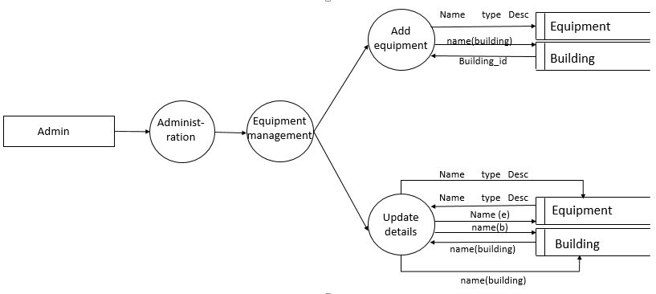

Level 1.3 for Admin (Equipment management)

Slide 12
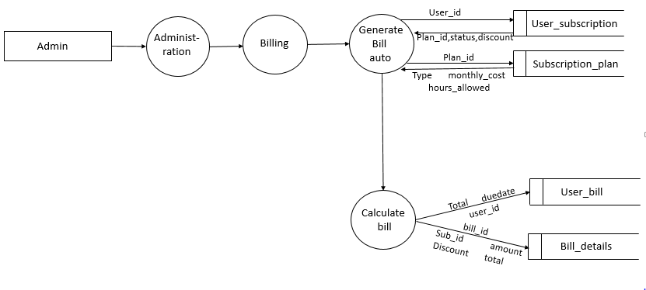
Level 1.4 for Admin (Billing)

Slide 13
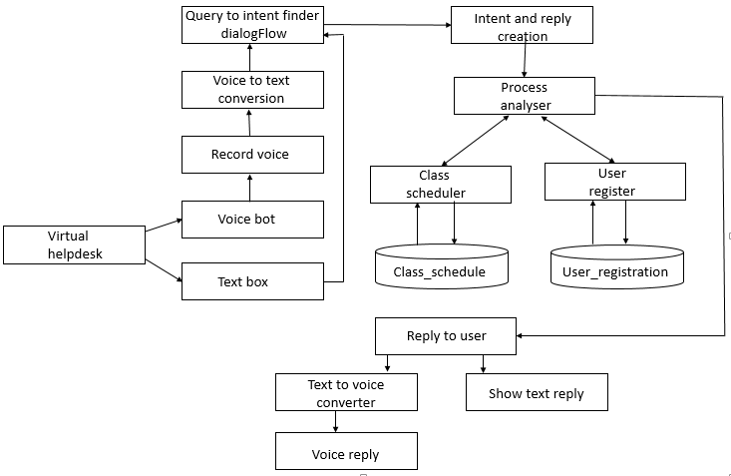
Block diagram for virtual helpdesk

Slide 14
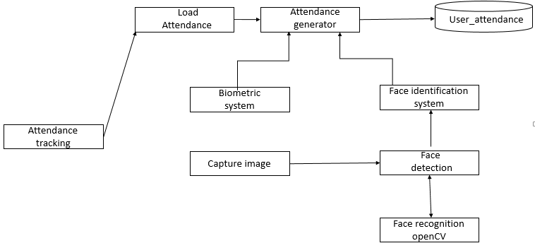
Block diagram for attendance tracking

Slide 15
DATABASE DESGIN
Table name: Admin_login primary key: Admin_login_id
Description : details of admin login
Field | Datatype | Size | Constraints | Description
Admin_login_id | Integer | 11 | Primary key | Id of admin login
Username | Varchar | 15 |  | Username of admin
Password | Varchar | 15 |  | Password of admin

Slide 16
Table name:staff_login primary key:Staff_id
Description: details of staff login
Field | Datatype | Size | Constraints | Description
Staff_id | Integer | 11 | Primary key | Id of staff
Type | Varchar | 15 |  | Type of staff
Username | Varchar | 15 |  | Username of staff
Password | Varchar | 15 |  | Password of staff

Slide 17
Table name: staff_registration primary key:Staff_reg_id
Description : details of staff registration
Field | Datatype | Size | Constraints | Description
Staff_reg_id | Integer | 11 | Primary key | Id of staff registration
Staff_id | Integer | 11 | Foreign key | Id of staff
Block | Varchar | 10 |  | Block of staff
Name | Varchar | 30 |  | Name of staff
Phone | Varchar | 15 |  | Phone no of staff
Email | Varchar | 40 |  | Email id of staff
Address | Text |  |  | Address od the staff
Salary_hour | Double |  |  | Salary hours of staff
Table used: staff_login

Slide 18
Table name: class_schedule primary key:Schedule_id
Description: details of schedule
Field | Datatype | Size | Constraints | Description
Schedule_id | Integer | 11 | Primary key | Id of the schedule
User_id | Integer | 11 | Foreign key | Id of the user
Staff_id | Integer | 11 | Foreign key | Id of the staff
Start time | Datetime |  |  | Schedule’s start time
End time | Datetime |  |  | Schedule’s end time
Type | Varchar | 15 |  | Type of the schedule
Table used: staff_login , user_registration

Slide 19
Table name: building primary key:building_id
Description: details of building
Field | Datatype | Size | Constraints | Description
Building_id | Integer | 11 | Primary key | Id of the building
Name | Varchar | 30 |  | Name of the block
Number | Integer | 11 |  | Number of block
Table name: equipment primary key:Equipment_id
Description: details of equipment
Field | Datatype | Size | Constraints | Description
Equipment_id | Integer | 11 | Primary key | Id of the equipment
Name | Varchar | 40 |  | Name of the equipment
Type | Varchar | 15 |  | Type of equipment
Building_id | Integer | 11 | Foreign key | Id of building
Desc | Text |  |  | Descriptions
TABLE USED : Building_id

Slide 20
Table name: user_bill primary key:Bill_id
Description : details of user bill
Field | Datatype | Size | Constraints | Description
Bill_id | Integer | 11 | Primary key | Id if the bill
User_id | Integer | 11 | Foreign key | Id of the user
Total_amount | Double |  |  | Total amount to be paid
Due_date | Double |  |  | Due date of the payment
Paid_amount | Double |  |  | Details of paid amount
Table used: user_registration

Slide 21
Table name:subscription_plan primary key:Plan_id
Description: details of subscription plan
Field | Datatype | Size | Constraints | Description
Plan_id | Integer | 11 | Primary key | Id of plan
Type | Varchar | 15 |  | Type of plan
Building_id | Integer | 11 | Foreign key | Id of building
Monthly_cost | Double |  |  | Monthly cost plan
Hours_allowed | Double |  |  | Allowed hours details
Table used:building

Slide 22
Table name: user_Subscription primary key:User_subscription
Description : details of user subscription
Field | Datatype | Size | Constraints | Description
User_subscription_id | Integer | 11 | Primary key | Id of user subscription
Plan_id | Integer | 11 | Foreign key | Id of plan
Status | Varchar | 50 |  | Status subscription
Discount | Double |  |  | Discount available
User_id | Integer | 11 | Foreign key | Id of user
Table used:subscription_plan,user_registration

Slide 23
Table used:user_bill, user_registration
Table name :bill_details primary key: Bill_details_id
Description: details of bill
Field | Datatype | Size | Constraints | Description
Bill_details_id | Integer | 11 | Primary key | Id of bill details
Bill_id | Integer | 11 | Foreign key | Id of bill
User_sub_id | Integer | 11 | Foreign key | Id of user
Amount | Double |  |  | Total amount
Discount | Double |  |  | Discount available
Total | Double |  |  | Total sum up

Slide 24
Table name:staff_attendance primary key:Staff_attendance_id
Description: details of staff attendance
Field | Datatype | Size | Constraints | Description
Staff_attendance_id | Integer | 11 | Primary key | Id of staff attendance
Staff_id | Integer | 11 | Foreign key | Id of staff
Log_in time | Datetime |  |  | Login time of staff
Log_out time | Datetime |  |  | Logout time of stff
Total hours | Double |  |  | Total hours worked
Salary | Double |  |  | Salary of staff
Table used: staff_login

Slide 25
Table name:user_attendance primary key: User_attendance
Description: details of user attendance
Field | Datatype | Size | Constraints | Description
User_attendance | Integer | 11 | Primary key | Details of user attendance
User_id | Integer | 11 | Foreign key | Id of user
Log_in | Datetime |  |  | Login details of user
Log_out | Datetime |  |  | Logout details of user
Total_time | Double |  |  | Total time user used
Part | Varchar | 15 |  | Part of user
Table used :user_registration

Slide 26
SCREENSHOTS
http://www.free-powerpoint-templates-design.com

Slide 27
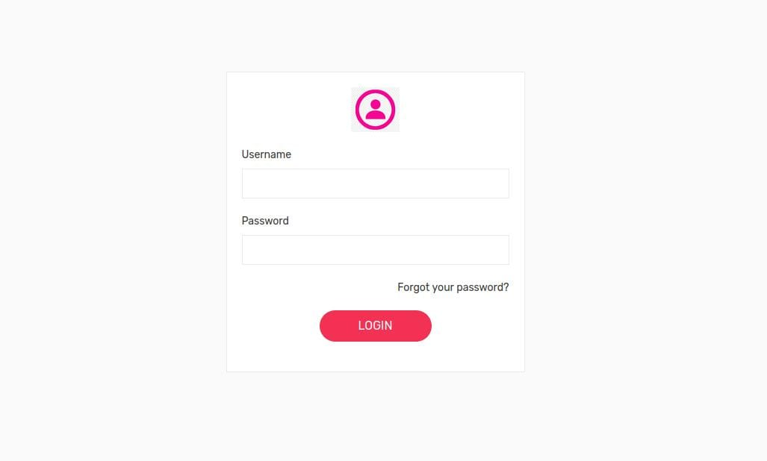
ADMIN LOGIN

Slide 28
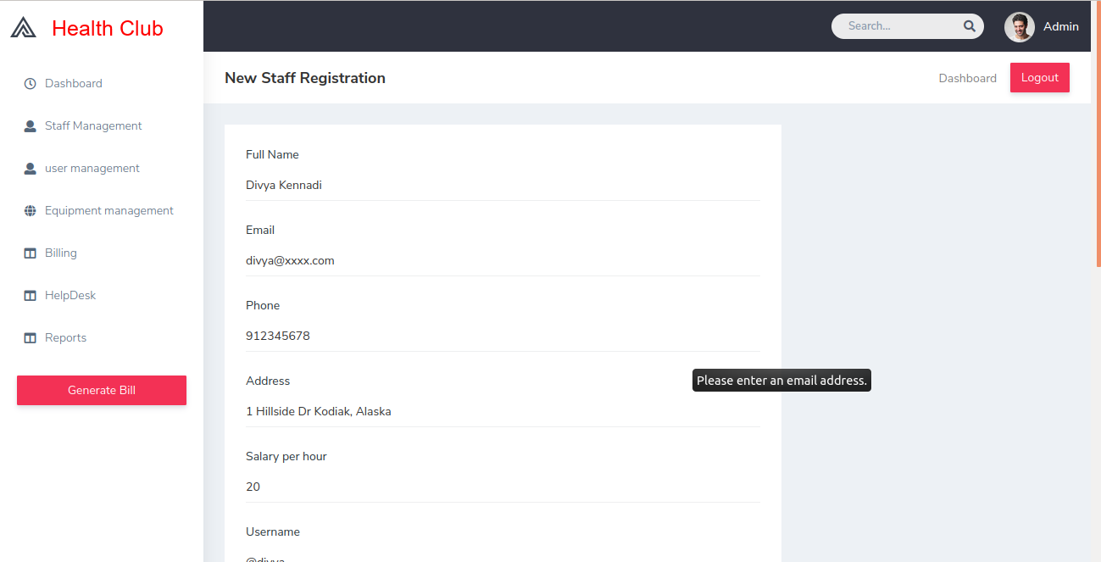
NEW STAFF
REGISTRATION 1

Slide 29
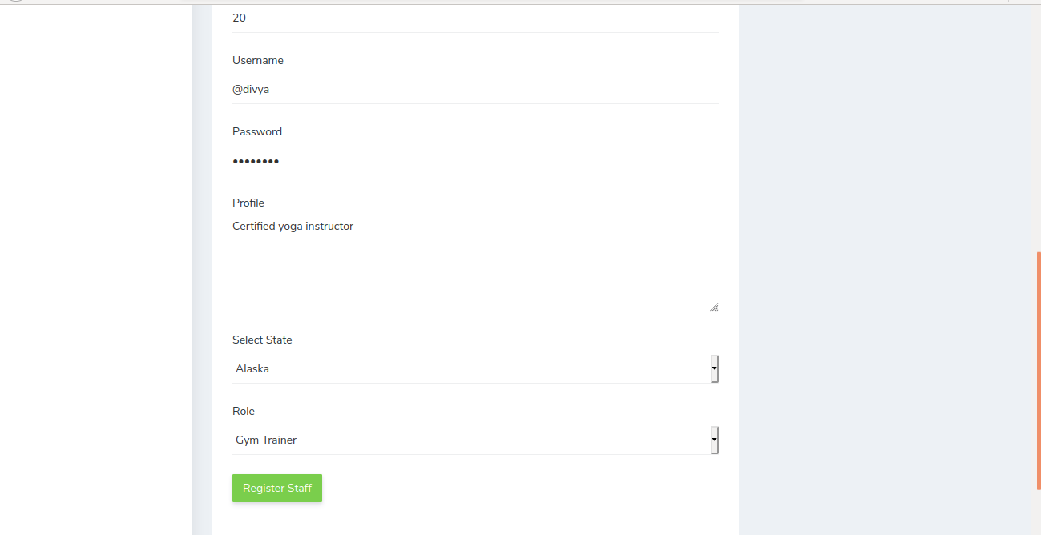
NEW STAFF
REGISTRATION 2

Slide 30
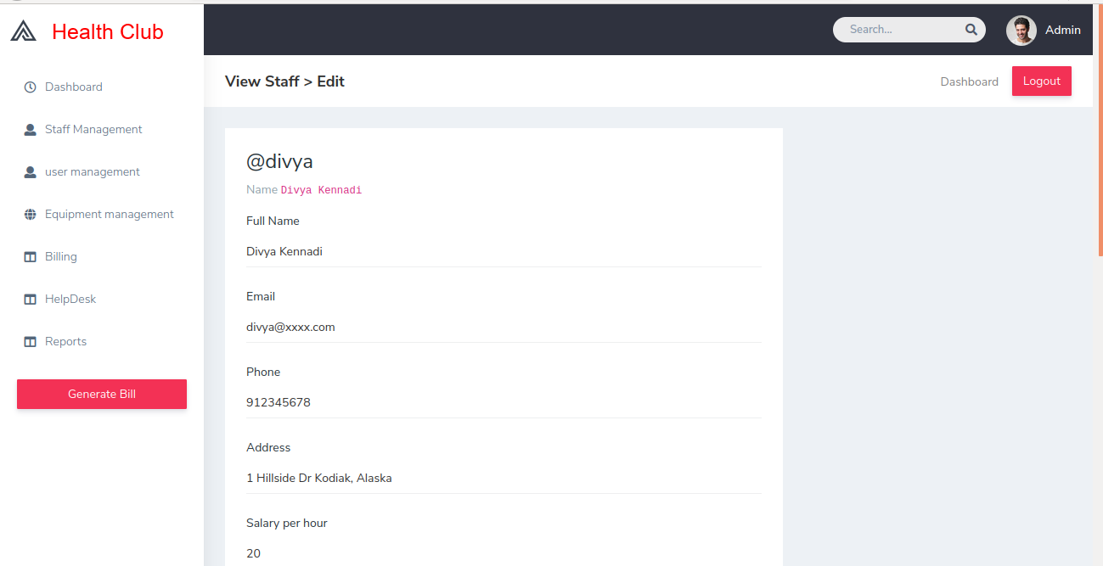
EDIT STAFF

Slide 31
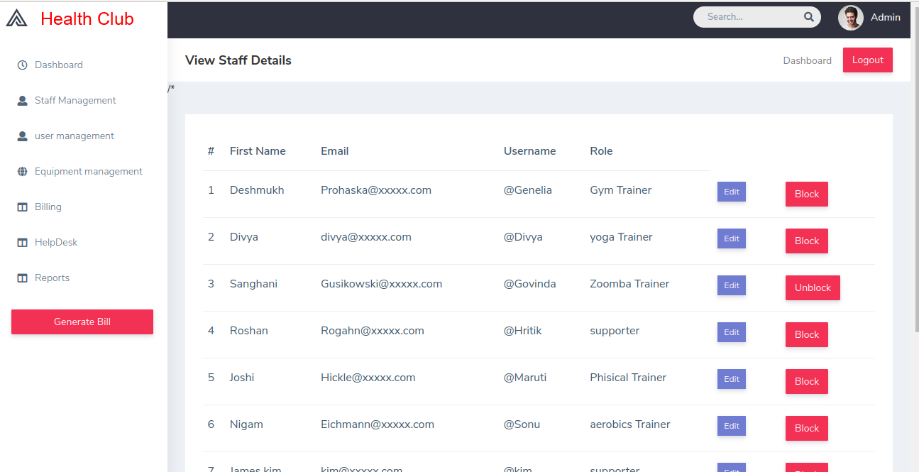
VIEW STAFF
DETAILS

Slide 32
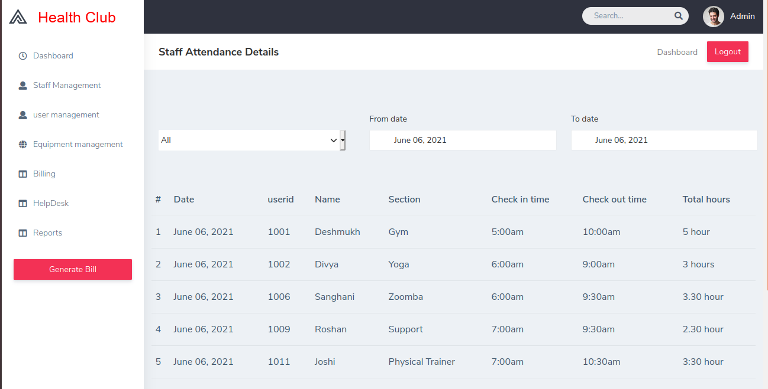
STAFF ATTENDANCE

Slide 33
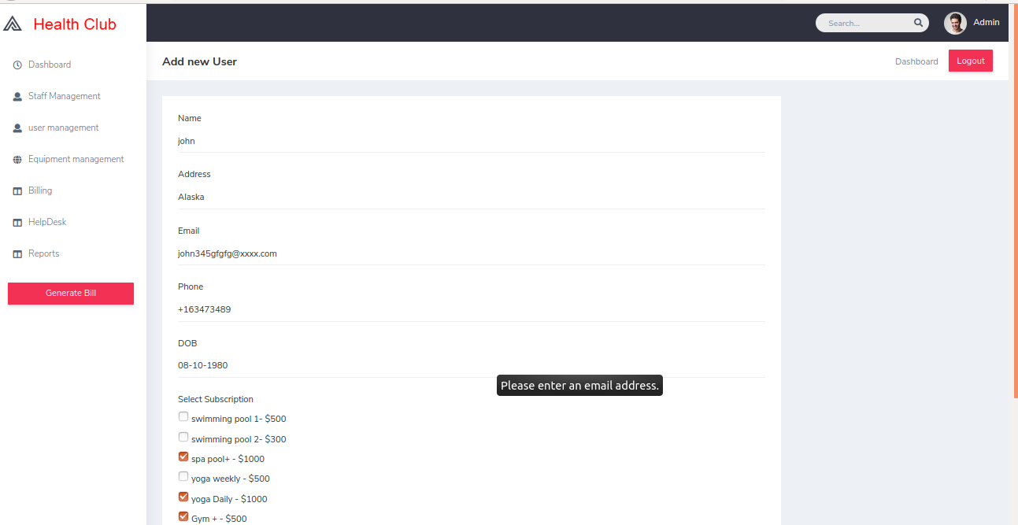
ADD USER

Slide 34
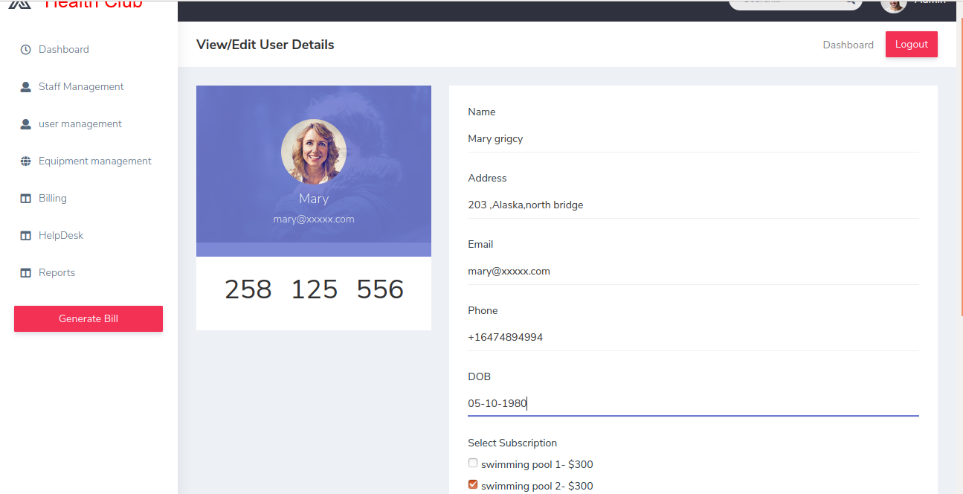
VIEW OR EDIT
USER DETAILS

Slide 35
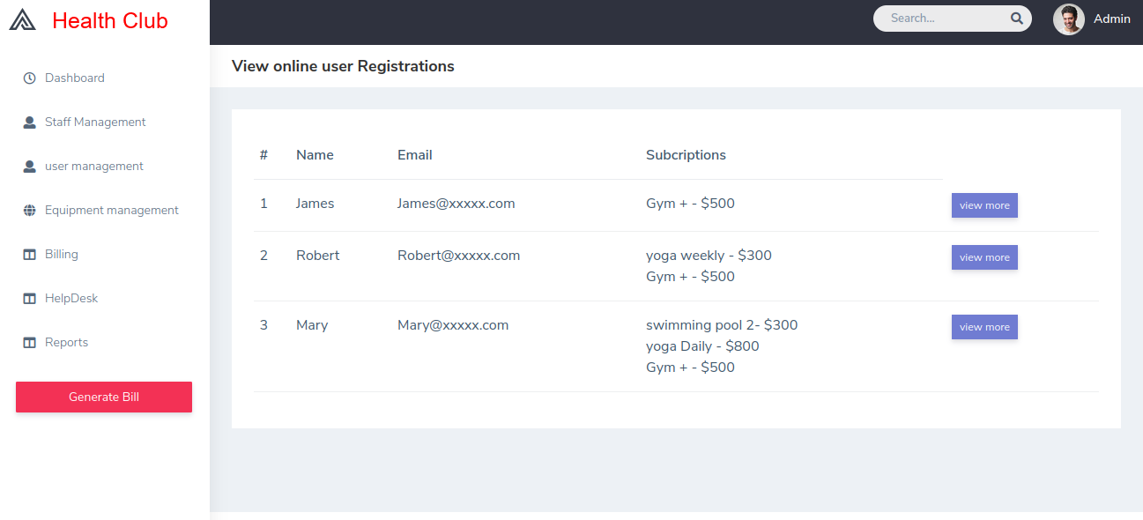
VIEW ONLINE
USER REGISTRATION

Slide 36

USER ATTENDANCE

Slide 37
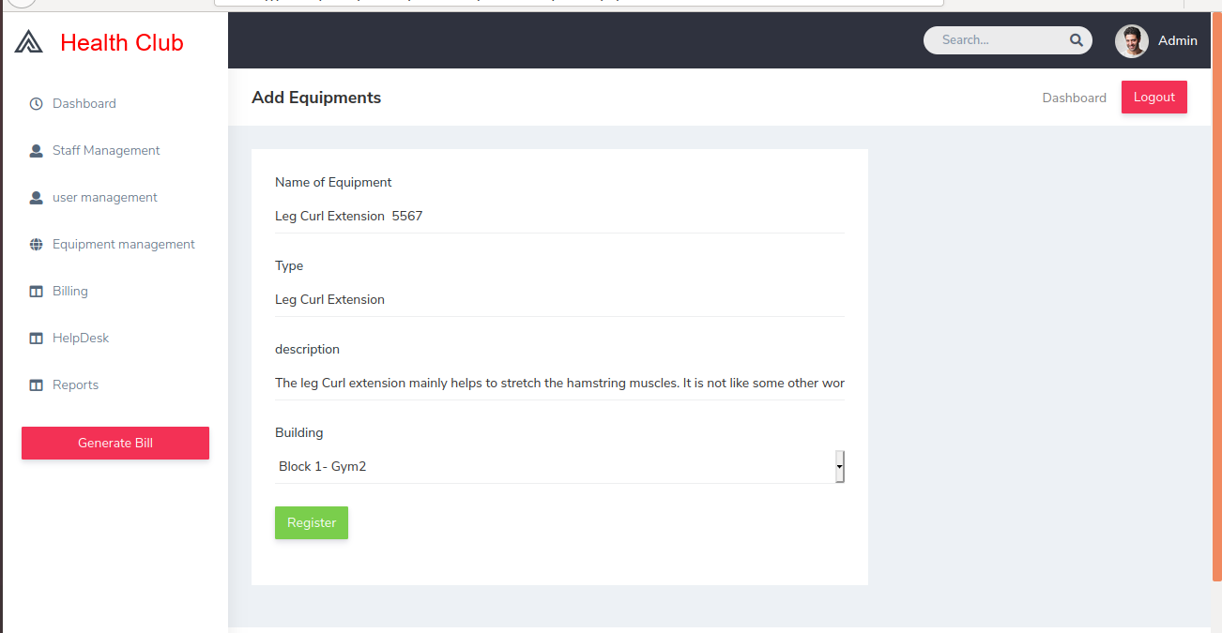
ADD EQUIPMENT

Slide 38
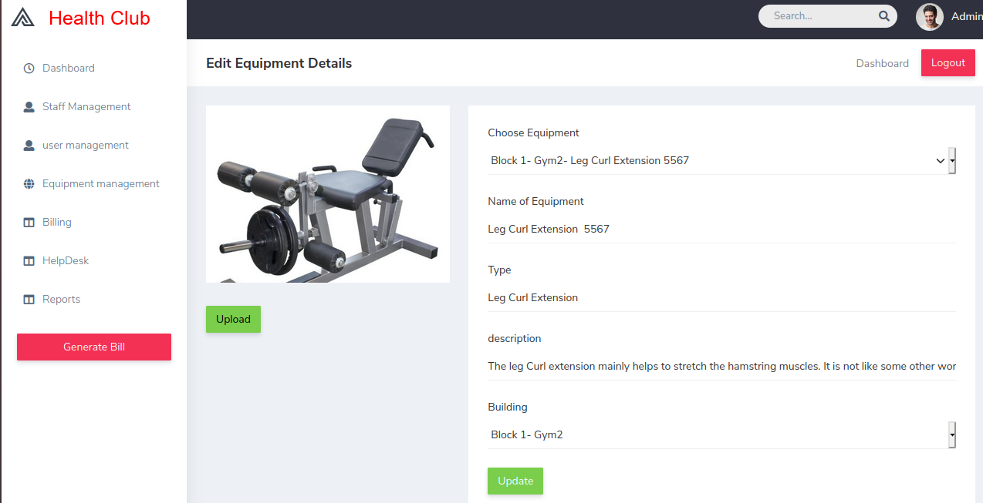
EDIT EQUIPMENT

Slide 39
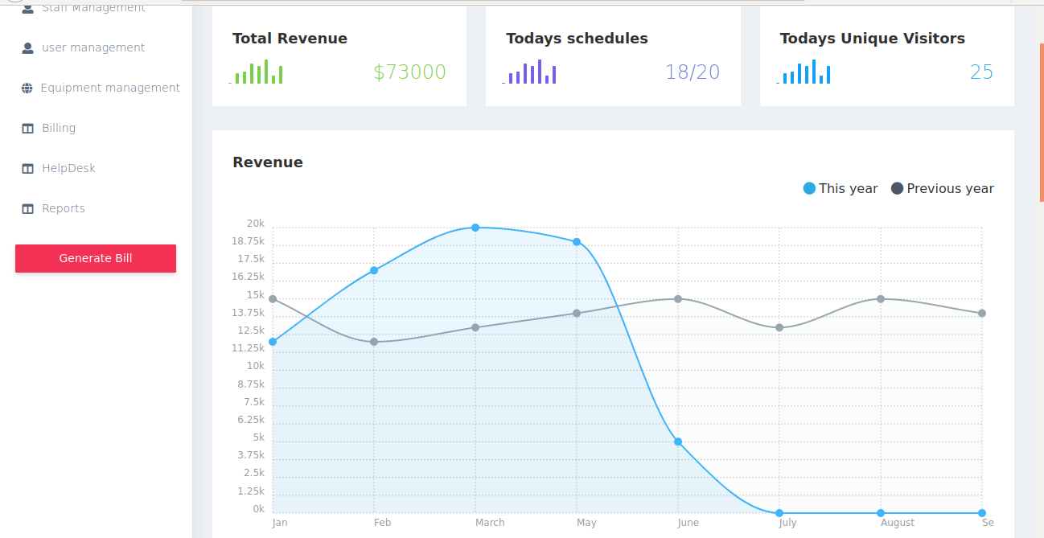
DASHBOARD

Slide 40
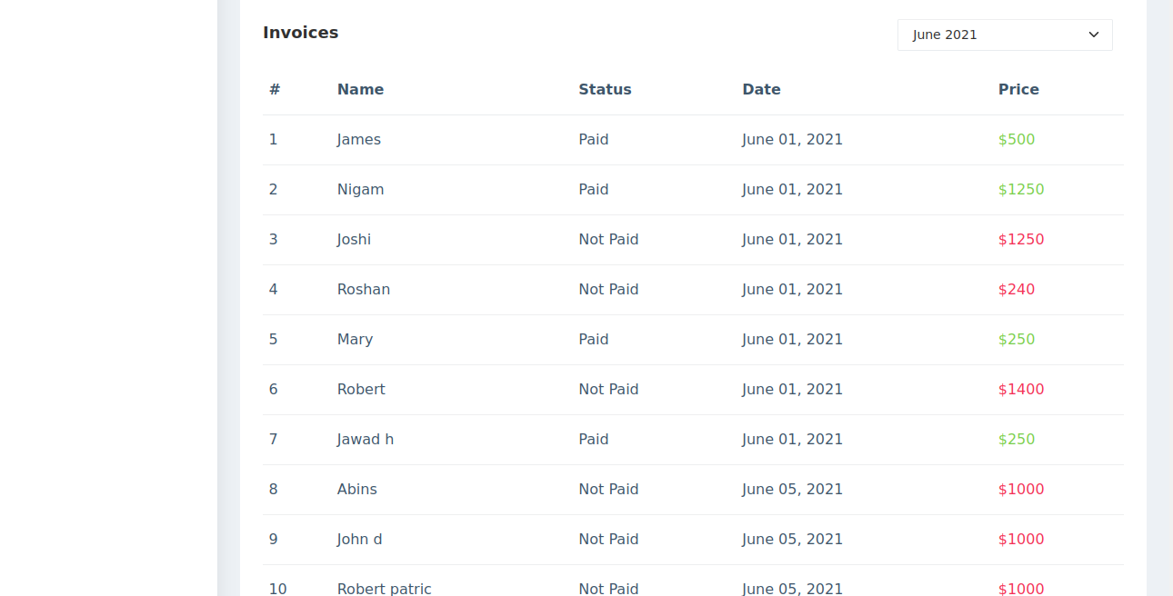
INVOICES

Slide 41
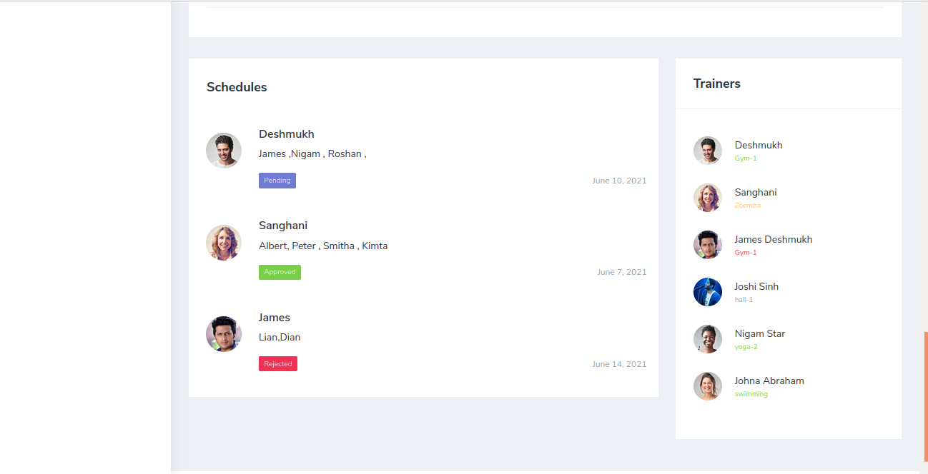
SCHEDULE

Slide 42
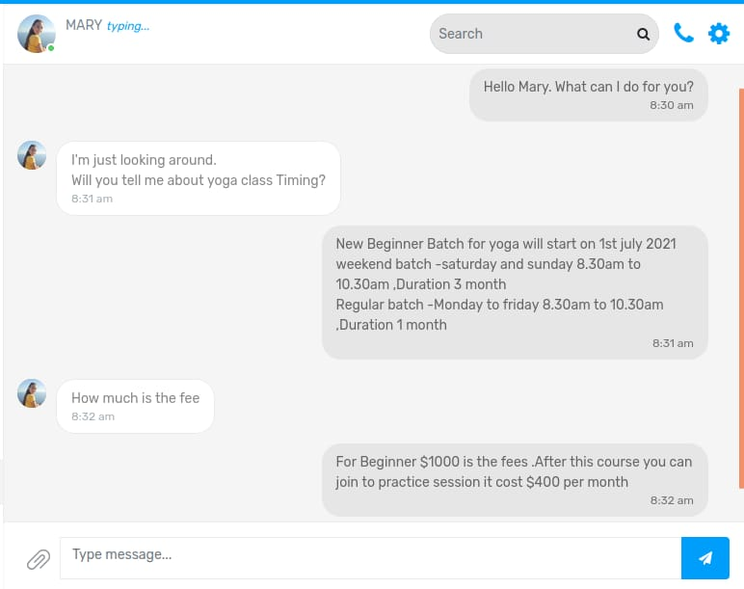
HELPDESK

Slide 43
CONCLUSION
AI based Integrated Health Club management system

Slide 44

In previous work human has to adjust to the timing of the health club and it was difficult to manage the schedules, payments, manual attendance etc. this make uncomfortable for users and staff. And the management is forces to appoint more members to manage the health club duties and it make expensive.
1
2
Thus proposed system is more reliable than the previous existing systems
24/7 access control for the user
The attendance is managed using face recognition and biometric. .This system marks attendance from multiple locations with a cloud stored database
3
4
automated notification
Dynamic employee scheduling
notifications for trainers and class instructors to help keep employees organized.

Slide 45
FUTURE ENHANCEMENT
This project can be modified at any time by adding any more features and can develop the databases with more new features.
.
Can make more accessible and friendly for user with adding technologies using IOTs, Robots etc.
Virtual reality can be implemented that is a person interacting with three dimensional environment using electronic devices.
.
Future work include video analysing of equipment and predict the life of the equipment’s.
.

Slide 46
Journal and Publications
Chen Chi-Lun, "The study of Members' Participating Motivation Customer Satisfaction and Repurchase Intention about Health and Fitness Club-A case study of GYMLUX FITNESS CLUB", Master dissertation, 2007.
V. S. Manjula and L. D. S. S. Baboo, "Face detection identification and tracking by PRDIT algorithm using image database for crime investigation", Int. J. Comput. Appl., vol. 38, no. 10, pp. 40-46, Jan. 2012.
REFERENCE
BOOKS
Kenneth.S.Rubin, Essential Scrum: A Practical Guide to the Most Popular Agile Process, First Edition
Allen B. Downey Think Python: An Introduction to Software Design, Second Edition
OpenCV —Python Core— [online]
.

Slide 47
THANK YOU

